Slide 1
La Corrida de Toros
A look at both sides of a deeply-rooted tradition in Spanish and Hispanic culture

Slide 2
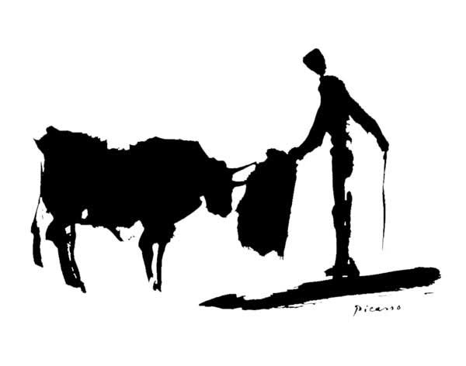
La Historia
Many ancient civilizations honored bulls. Crete (Greek island) is very well-known.
The toro bravo, an ancient species of bull, has been conserved only in Spain.
Bulls played an important role in Iberian tribes in pre-historic times.
The Bible also talks about sacrificing bulls in honor of divine justice.
**Remember, Spain is very Catholic.
During the Middle Ages, fighting bulls on horseback was a common form of entertainment for the aristocracy.

Slide 3
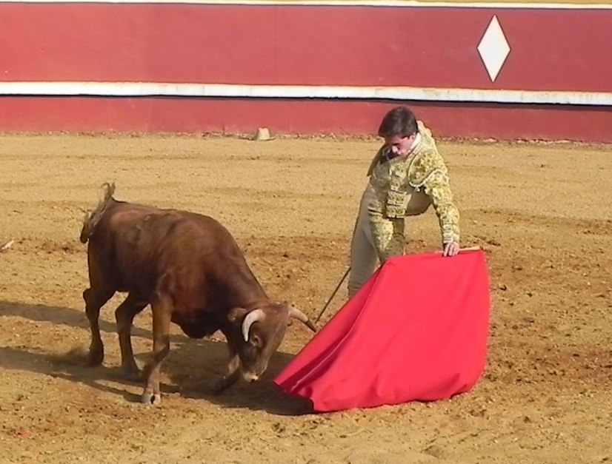
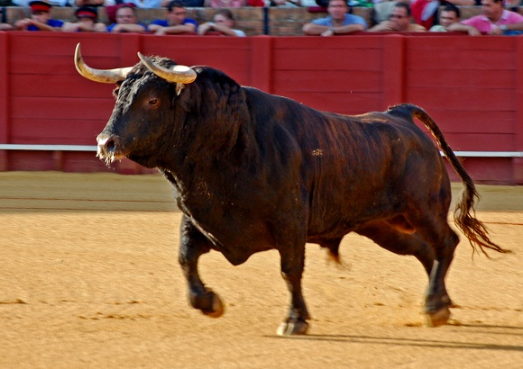
Vocabulario:Animales
Novillos: Male bulls less than 3 years old. Used to train Novilleros (young bullfighters)
Toro Bravo: Brave bulls selected to fight based on their intensity and aggressiveness.

Slide 4
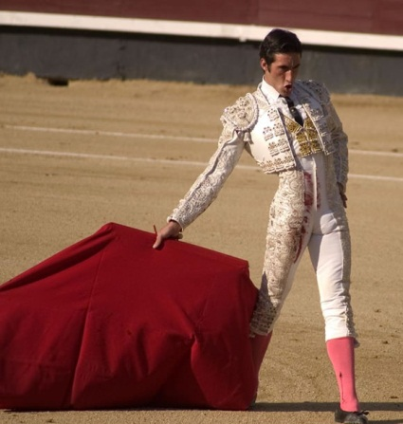
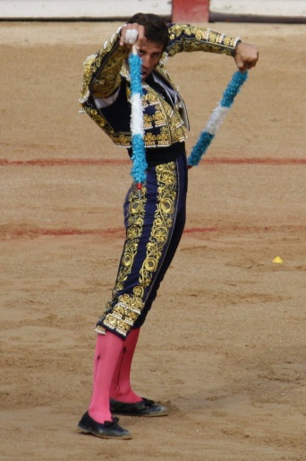
Vocabulario:Bullfighters
Banderilleros: “Flagmen” who place the banderillas. They are part of the 1st and 2nd tercio.
Matadores: “Killer” This is the professional bull fighter who fights the bull.
Novillero: Junior bull fighter.
Torero: General term for a bullfighter. Includes: Banderilleros, picadores, and matadores.
Picadores: “Lancers” mounted on horseback. They perform in the 1st tercio.

Slide 5
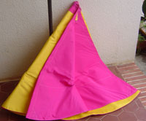
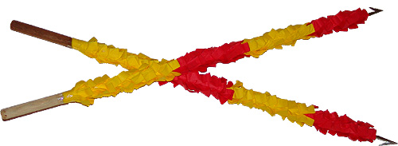
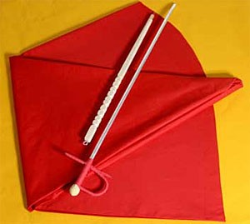
Vocabulario:The Fight
Banderillas: Barbed flags used to loosen the neck muscles of the bull.
Capote: Gold and magenta cape used on the first third of the fight.
Estocada: The final thrust of the sword that kills the bull.
Muleta: Red cape used in the third stage of the fight.
Indulto: Rarely, a bull will be spared for a brave and valiant fight. It will be used instead to breed.

Slide 6
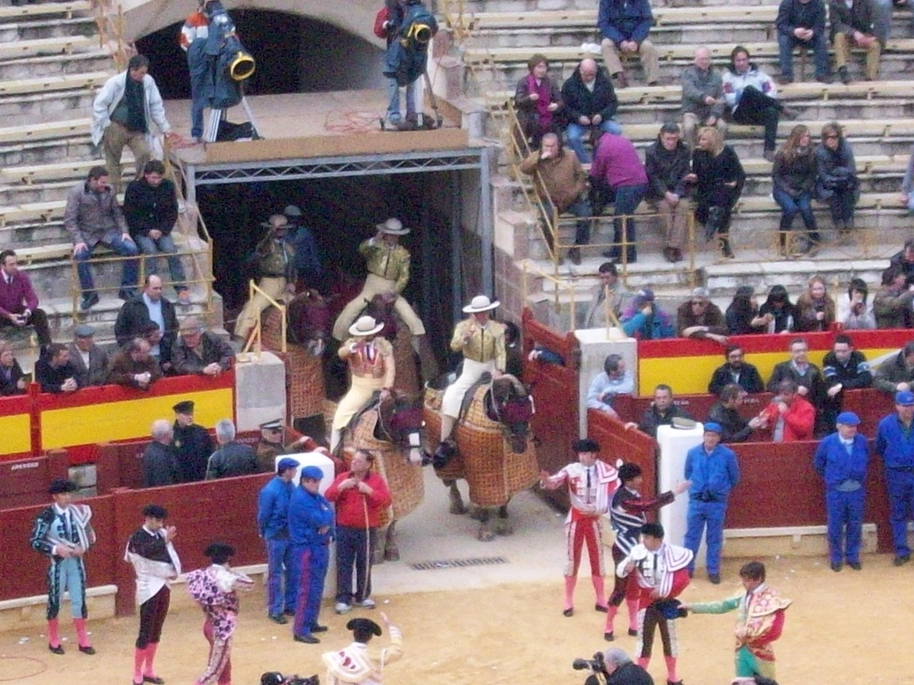
What is a Corrida de Toros?
Corrida de Toros is a highly ritualized three-staged bullfight where the matador fights a bull in a ring.
The Corrida starts with the paseillo, where everyone involved is presented to the spectators in a parade-like fashion.

Slide 7
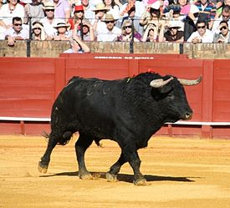
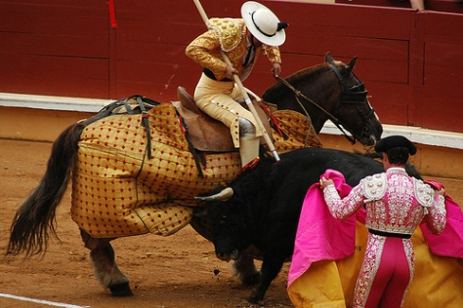
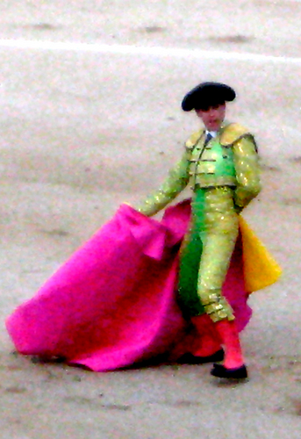
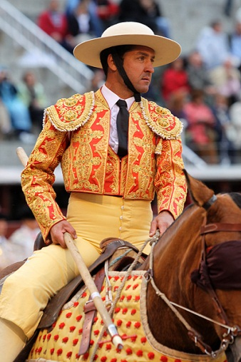
What happens in a Corrida?
Tercio de Varas (Third of Lances)- Paso Uno
Matador and Banderilleros enter the ring to test the bull with required tandas (series of passes) using a capote.
Two picadores then enter the arena, on horseback, armed with long lances. The horses are padded and blindfolded for protection.
The matador uses this stage to test the bull’s intensity and observe its behavior in the ring.
The picadores use the lances to loosen the neck muscles of the bull. This stage helps to tire the bull out and keep its head lower for the remainder of the fight.

Slide 8
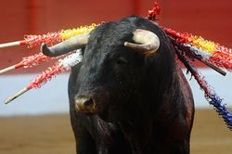
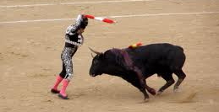
What happens in a Corrida?
Tercio de Banderillas (Third of Flags)- Paso Dos
Three banderilleros attempt to place two banderillas each into the bull’s neck.
The banderillas are barbed sticks that serve two purposes. The first is to help weaken the bull’s neck further. The second is to anger the bull, causing it to become more intense and charge more ferociously.

Slide 9
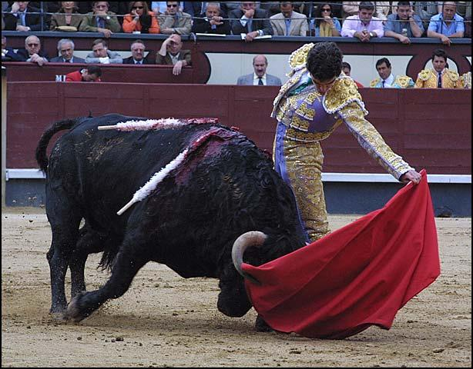
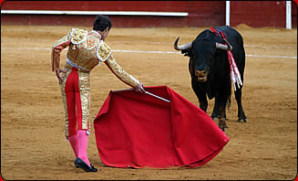
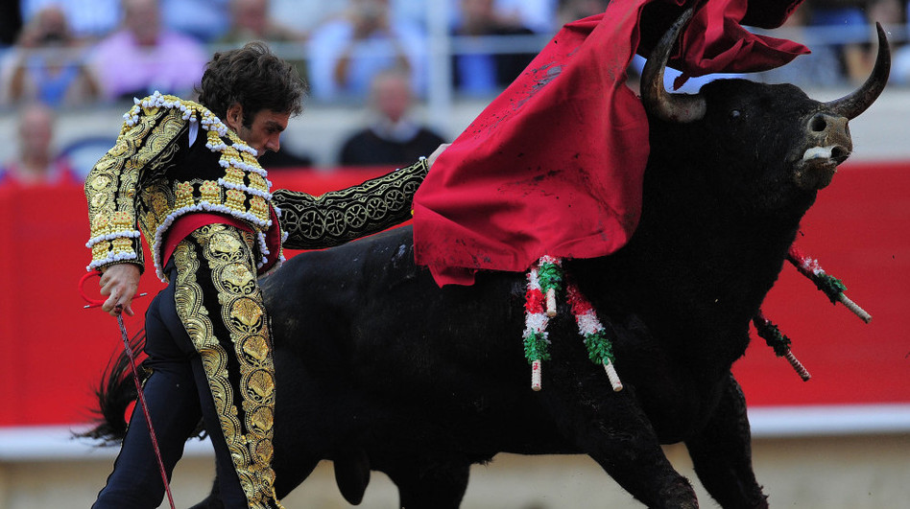
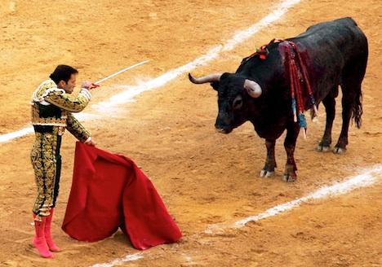
What happens in a Corrida?
Tercio de Muerte(Third of Death)- Paso Tres
The matador enters the ring with his red cape, or muleta. He has 15 minutes to kill the bull.
The matador attempts to kill the bull with estocada (thrusting the sword between the bull’s shoulders to sever the spinal cord and kill the bull immediately).
He performs a series of tandas (passes with the muleta). The last of the passes tries to position the bull.
If the estocada is unsuccessful, the puntillero completes a coup de grace using a dagger to ensure that the bull dies without suffering.

Slide 10
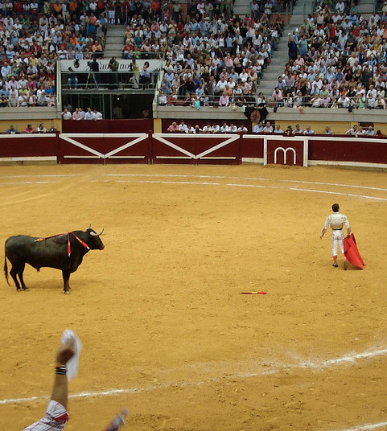
What happens after the Corrida?
If the bull performs exceptionally well, it is presented in front of the crowd for its honor.
In some places, the bull’s meat is sold for very cheap or given to the poor.
Rarely, but sometimes, the bull is granted indulto, and is spared death, by the crowd waving white handkerchiefs. That bull may never fight again due to its experience.

Slide 11
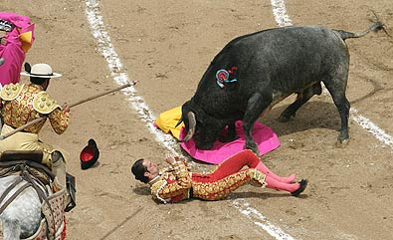
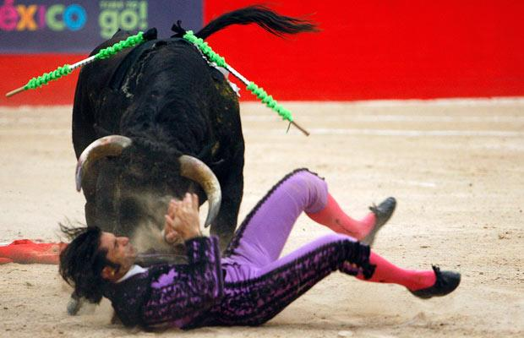
Isn’t the Corrida dangerous?
Bullfighting can be dangerous, but has become safer over the years for all participants. Horses are padded and protected, and the matador has surgical units ready in case of a goring. However, bulls are wild animals, and placing yourself in a ring with one, even with experience, is very dangerous.

Slide 12
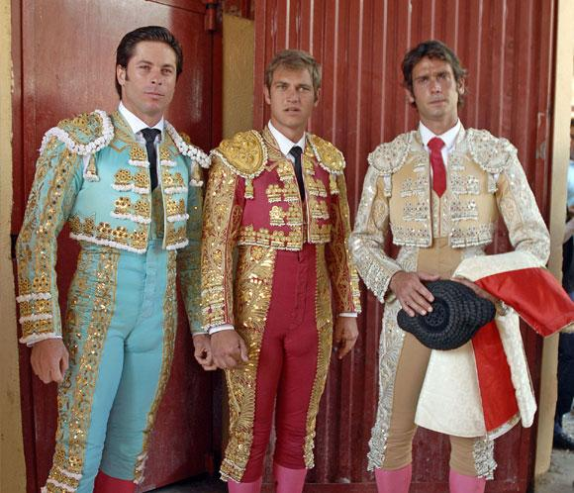
What is he wearing?
The suit that the matadores wear is called “Traje de Luces,” or “Suit of Lights.” It is very traditional.
The suit usually costs over 3.000 Euro and is decorated in gold.
Popular colors are red, green, black, blue, and white. Yellow is never worn, as it is seen as bad luck. The suit is worn with a white shirt, a narrow black tie, a sash, knee-high pink socks, black ballet-like slippers, and an astrakhan, which is a two-cornered hat.

Slide 13
Bibliography
Being a Torero. Dir. Anastasia Romanchuka and Joshua Pfluger. YouTube. YouTube, 25 May 2011. Web. 23 May 2013.
"Bullfighting." Bullfighting, Bullfighters, Bullrings in Andalucia, Southern Spain. Andalucia.com S.L., n.d. Web. 23 May 2013.
"Bullfighting Ritual." DonQuijote. Don Quijote Salamanca S.L., n.d. Web. 23 May 2013.
"Bullfighting Vocabulary." DonQuijote. Don Quijote Salamanca S.L., n.d. Web. 23 May 2013.
"For a Bullfighting-free Europe." For a Bullfighting-free Europe. Bullfighting-Free Europe, n.d. Web. 23 May 2013.

